Slide 1

CSE 302 Project Idea Presentation

Slide 2
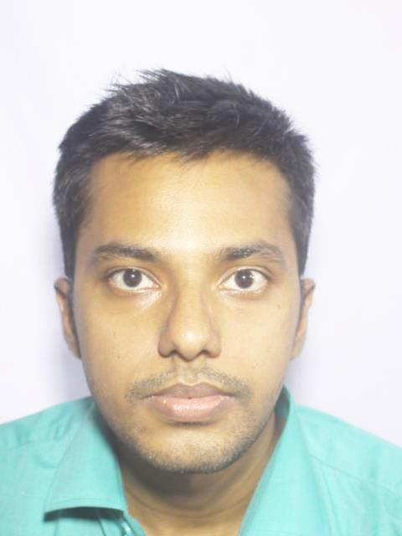
Group Members
Samirah Sohaili
ID: 201914041
Student of MIST
Abdullah Al Masum ID: 201914044
Student of MIST
Fahim Sharyr
ID: 201914019
Student of MIST

Slide 3
Railway Management System
1

Slide 4
Language & Tools
Application:
Web-app
Front-end:
Python Django Framework
Back-end: Python
DataBase: Oracle

Slide 5
Users
Admin
Normal person (naïve user)
Passenger (who has tickets)
Clerk in Ticket Counter
Train Master

Slide 6
Features
User credential (naive user)
Passenger info (who has ticket)
Train schedule (time table of trains)
Train Route (stoppage related)
Station info (platform, line no, train category)
Fare (related to class & train station)
Ticket booking in ticket counter

Slide 7
Features
Online ticket booking
Downloadable ticket
Ticket cancelling
Seat plan (carriage related)
Rail pass/ vending machine (QR code)
Fast Food in train service manage
Employee management section in train

Slide 8
Thanks!

